Slide 1
Emotion recognition through speech
Data Minions
Preethi Pantra – 16354674
Varni Priya Chilakapati - 16356159
Sowjanya Borusu- 16347843
Kanoj Reddy Gollamudi - 16352370

Slide 2
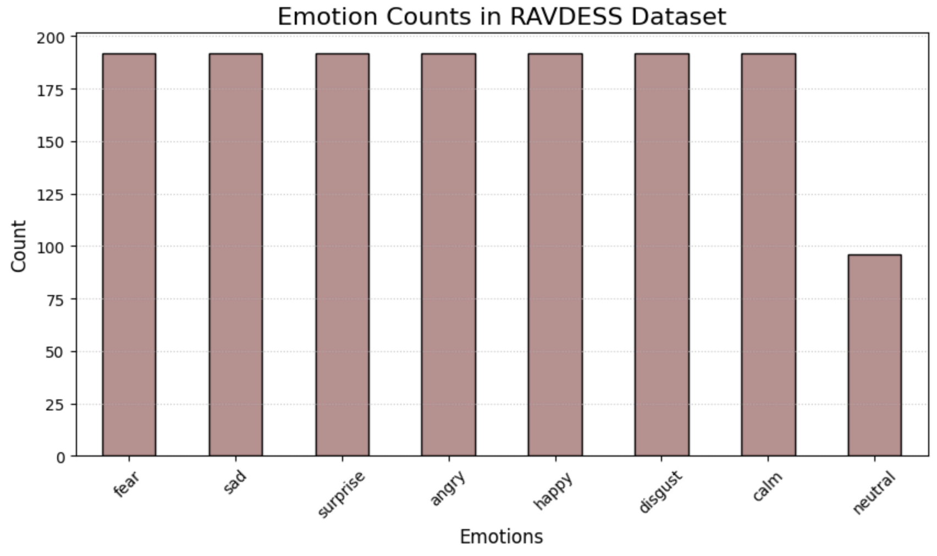
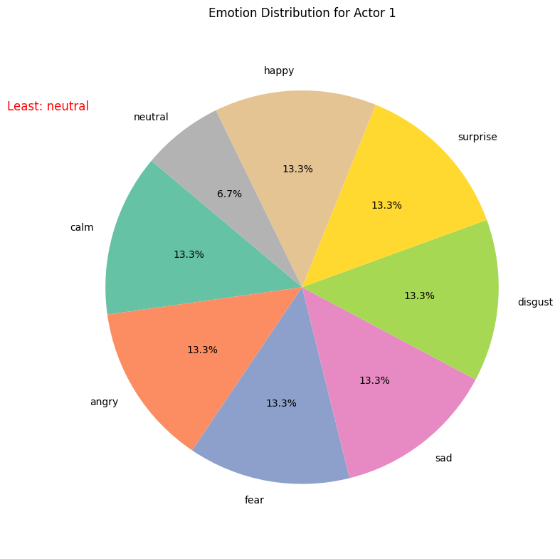
Exploratory Data Analysis
Bar graph represents number of audio files for each emotions
Pie chart shows emotions for Actor 1

Slide 3
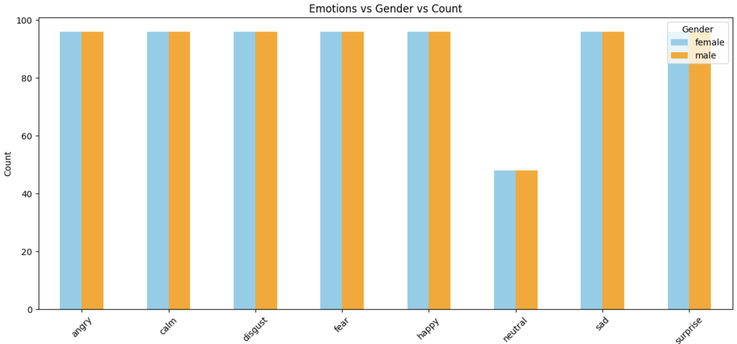
Bar graph represents number of audio files in each gender in given dataset

Slide 4
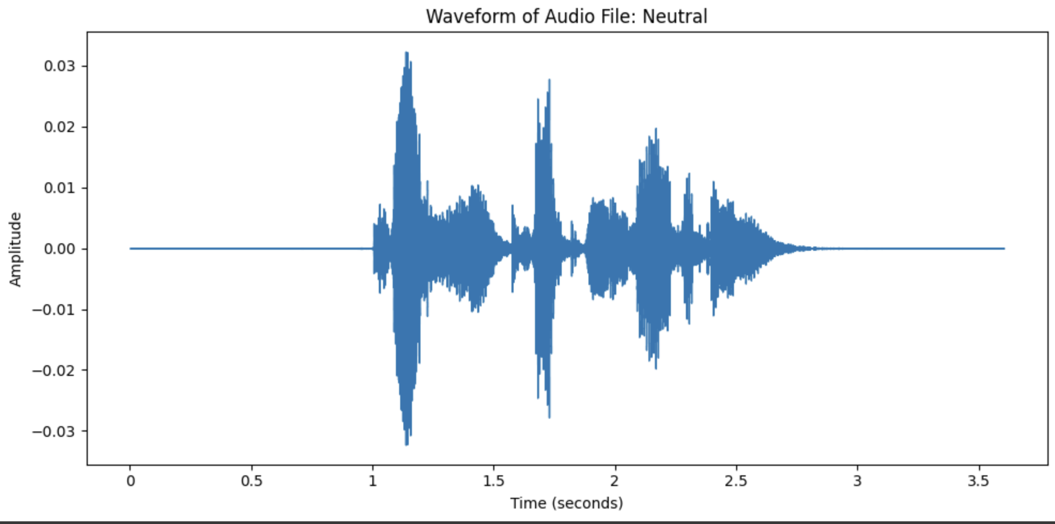
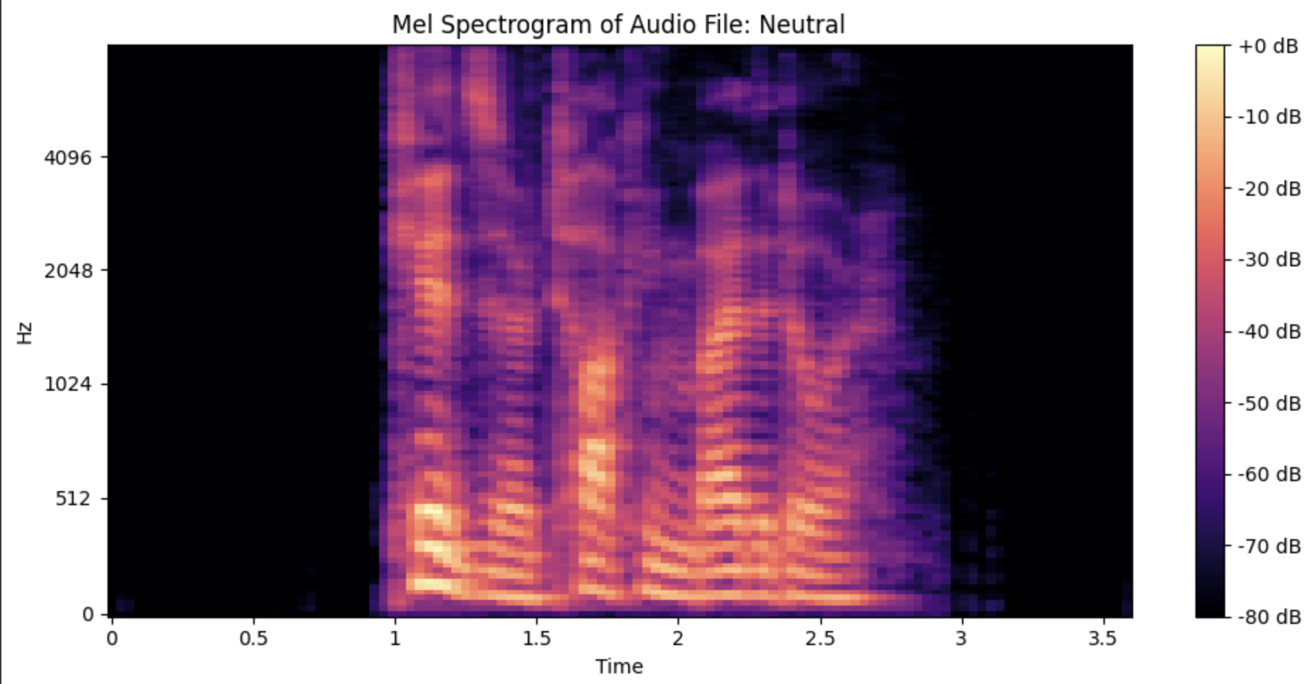
This image is a waveform representation of an audio signal labeled "Neutral.”
This image represents a spectrogram of an audio file labeled "Neutral."

Slide 5
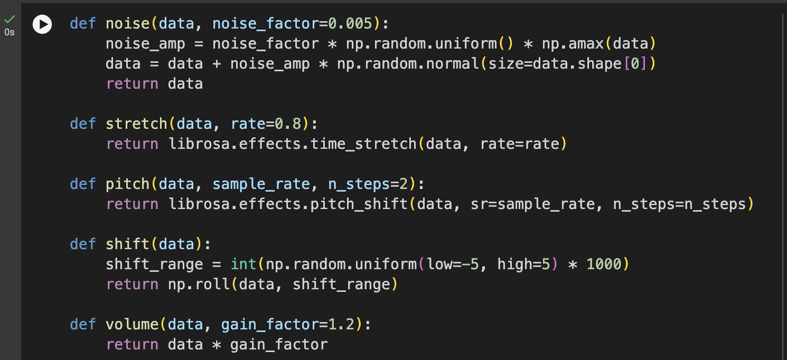
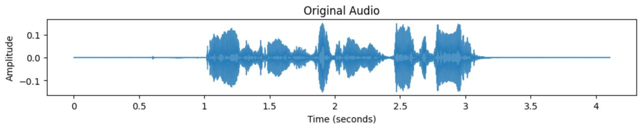
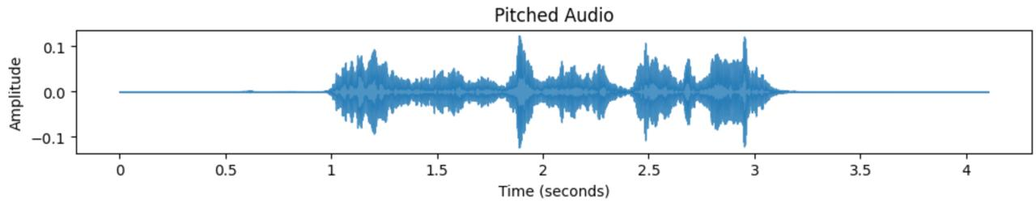

Data Augmentation

Slide 6
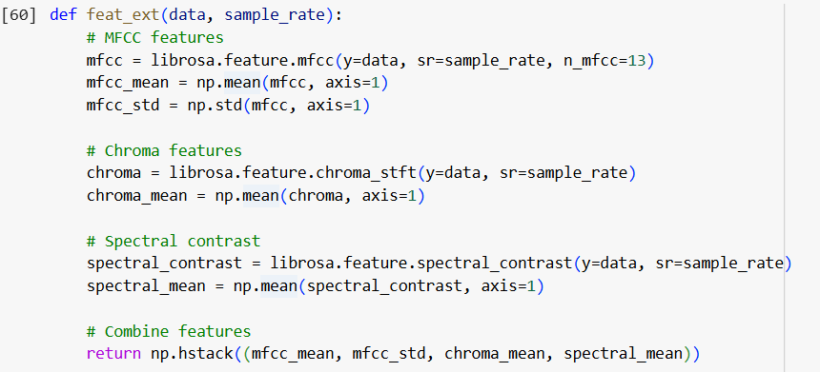
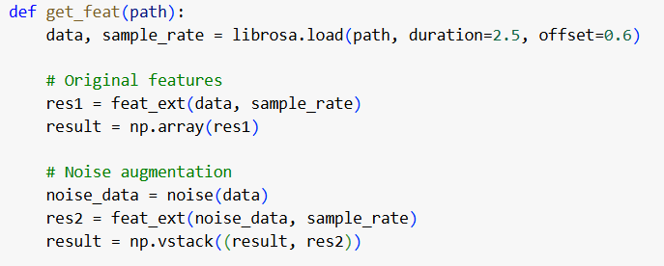
Feature Extraction
MFCC, chroma, spectral contrast features are extracted from audio signals with emotion labels and saved in emotion.csv file.

Slide 7
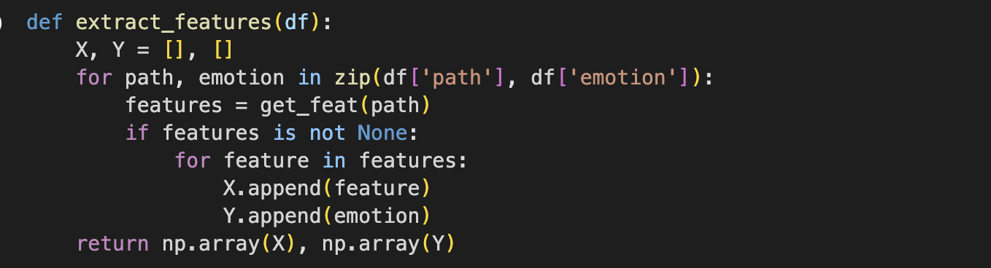
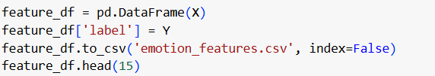

Slide 8
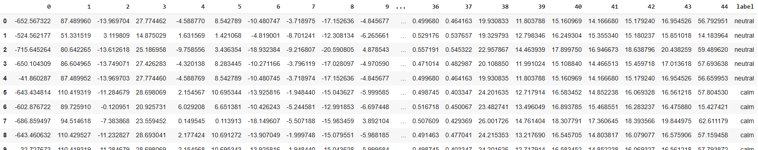

Slide 9
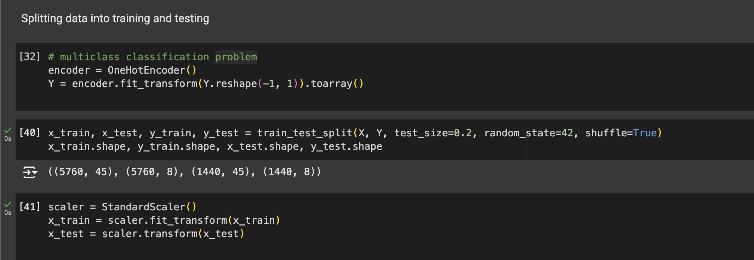
Data Preprocessing
This code performs data preprocessing, divides the dataset into training and testing subsets, and normalizes the features, ensuring they are ready for training a machine learning model for multiclass classification.

Slide 10
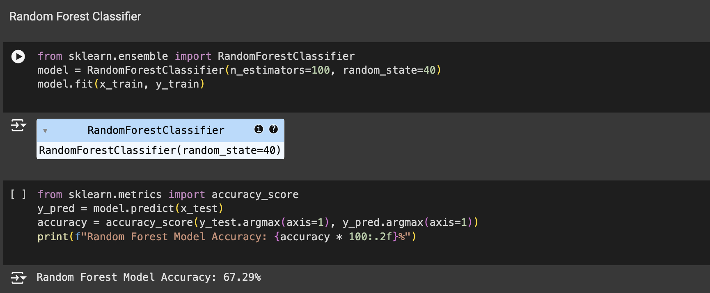
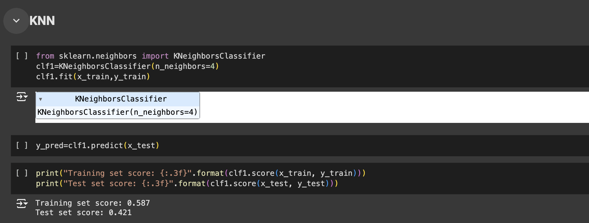
Deploying ML Models
→Random Forest Classifier → KNN

Slide 11
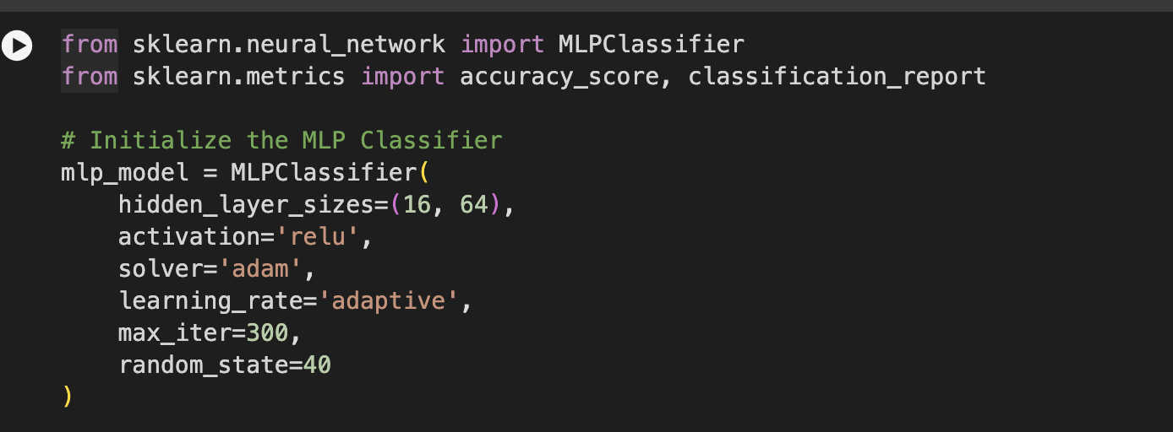
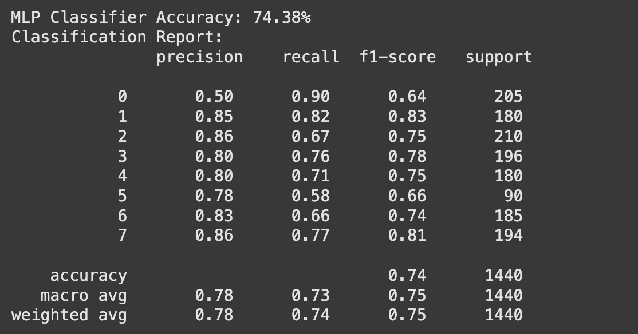
MLP

Slide 12
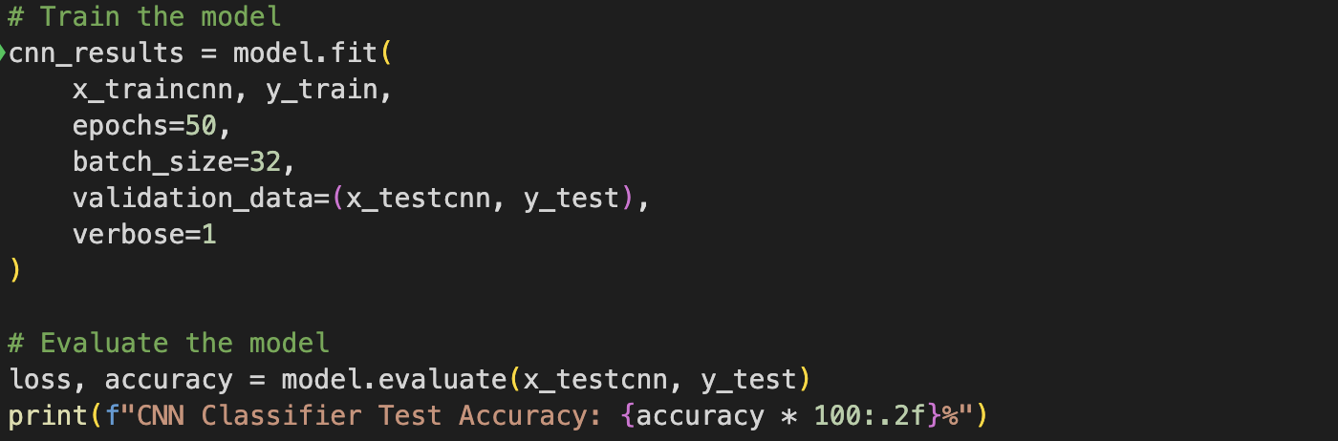
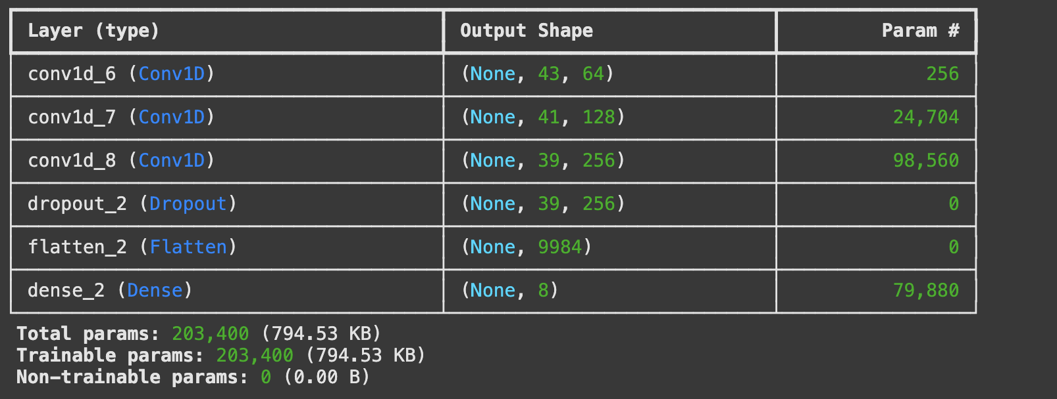
CNN
Convolutional Neural Network (CNN) architecture with several convolutional and pooling layers, followed by fully connected dense layers, designed for classifying sequential data.

Slide 13
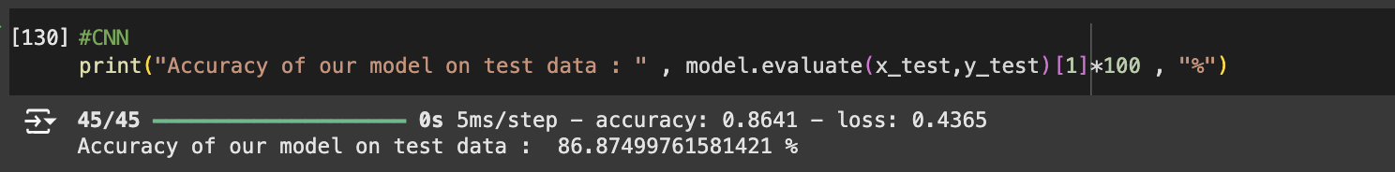
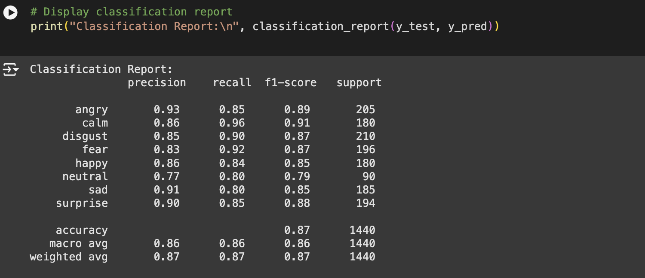
The CNN-based model achieved an accuracy of approximately 86.87% on the test data.

Slide 14
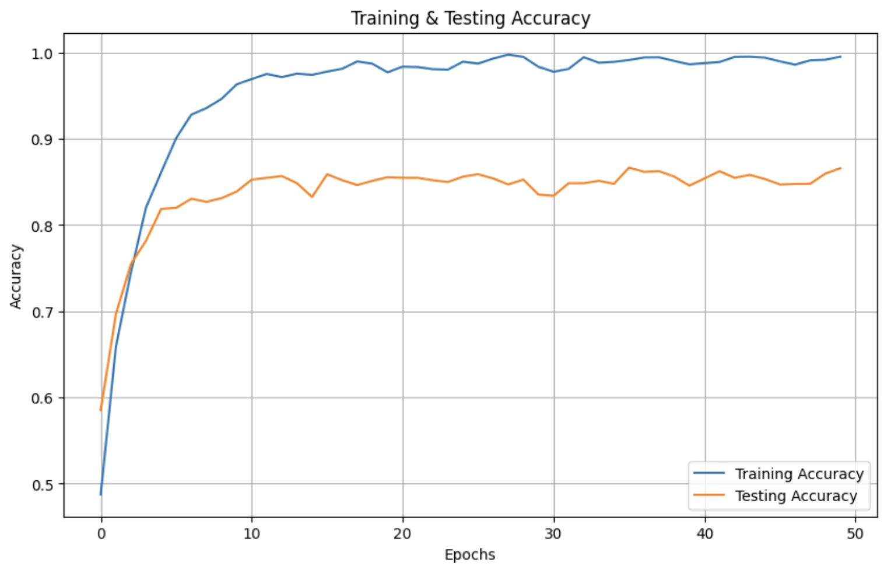
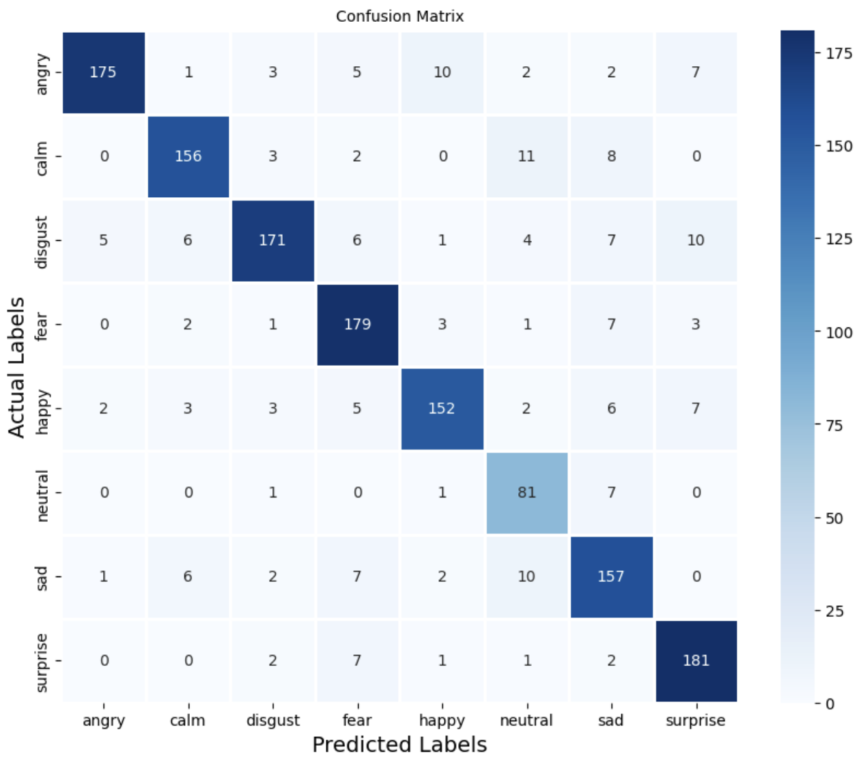
The CNN model achieved the highest accuracy of 86.70% on the test data, demonstrating its superiority over Random Forest, KNN and MLP models, attributed to its ability to automatically extract features from spatial data.

Slide 15
Thankyou

